Slide 1


TELECOM CHURN ANALYSIS
The goal of this project is to analyze customer churn data from a telecom company to uncover patterns, identify high-risk segments, and suggest data-driven strategies for customer retention.

Slide 2
PROJECT ROADMAP

Slide 3
OVERVIEW
Dataset: Used a dataset with 7,043 customer records including demographics, service usage, billing, and churn status.
Data Cleaning: Converted Total Charges to numeric, handled missing values, and ensured all columns were in usable formats.
Exploratory Analysis: Investigated churn based on tenure, contract type, payment method, and senior citizen status using pandas and visualization tools.
Key Insight: Senior citizens and customers with month-to-month contracts are more likely to churn.
Payment Method Impact: Highest churn rate was observed among customers using electronic checks.
Tenure Effect: Newer customers (tenure < 1 year) are most at risk, highlighting the need for better onboarding and engagement.
Business Impact: Findings can help design targeted retention strategies and personalized offers to reduce churn and improve profitability.

Slide 4

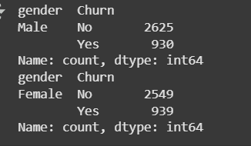
GENDER & AGE GROUP
Calculated the gender and age wise distribution of churned customer, this can help to identify the people belonging to specific category.
This will help to bring any particular plan for the age and gender group.
This code helps to count and group the data on the basis of gender
Churn ratio for male and female comes almost same =0.26(26%), so there is no corelation between gender and churn.
df.groupby('gender')['Churn'].value_counts()
total_male = df[df['gender'] == 'Male'].groupby('gender')['Churn'].value_counts()
total_female = df[df['gender']=='Female'].groupby('gender')['Churn'].value_counts()
OUTPUT

